Slide 1
Inventory management System
Made and presented by:
Name | Roll Number
Amaan Shaikh | 16010420070
Siddhesh Sanghavi | 16010420064
Adwait Saha | 16010420062

Slide 2
PROBLEM STATEMENT
Many workshops, grocery shops, small-scale vendors still rely on manual counting of items and maintaining
them in physical records such as books. These record are kept manually which increases the risk of manual error.
This might work in very-small scale business . However when it comes to a bit larger than that the chances of
Error increases as the scale of the inventory.
In such cases having software do this work for you not only minimizes your error in managing the inventory but
also increases the efficiency of work. It helps you to utilize your time effectively, hence saving time which can be
used for the better growth.

Slide 3
System Architecture
The code has different types of role to play to complete it’s task. It provides multiple features such as:
Adding item to inventory
Removing item from the inventory
Updating inventory
Searching item through inventory
Printing the overall inventory
We have used different function for each of this job ,so only that the function is called into the main which is
required by the user, making the program run a bit faster and error in a particular function doesn’t stop the whole
Program and lets the user operate other available functions

Slide 4
System Architecture
Display menu
ADD ITEM
Helps to add new item to the inventory along with the quantity available
REMOVE ITEM
Helps to remove item from the inventory if its supply has be stopped
UPDATE INVENTORY
Helps to reduce or increase amount of a product in the inventory
SEARCH ITEM DETAILS
Helps to get information about a certain product such as it’s availability and quantity
PRINT INVENTORY
Helps to get stock report at one place instead of counting individually.

Slide 5
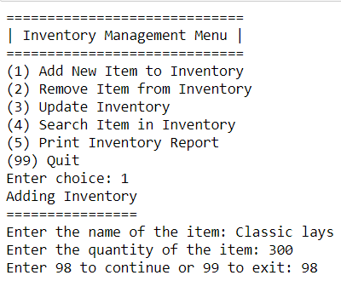
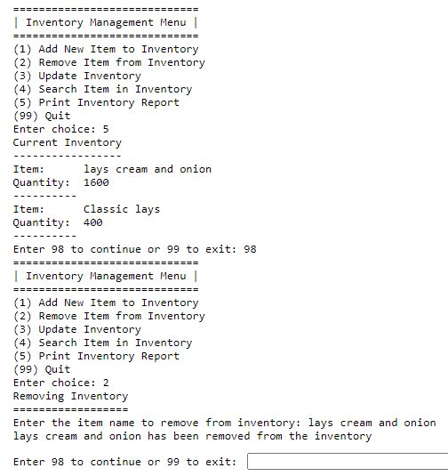
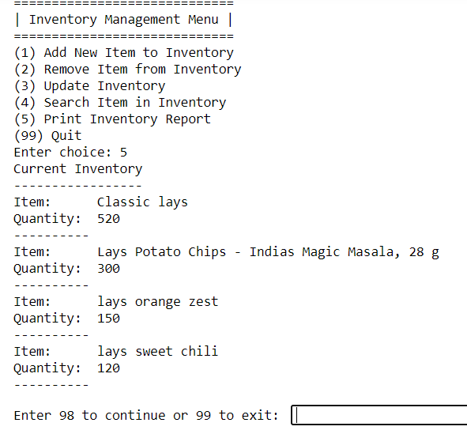
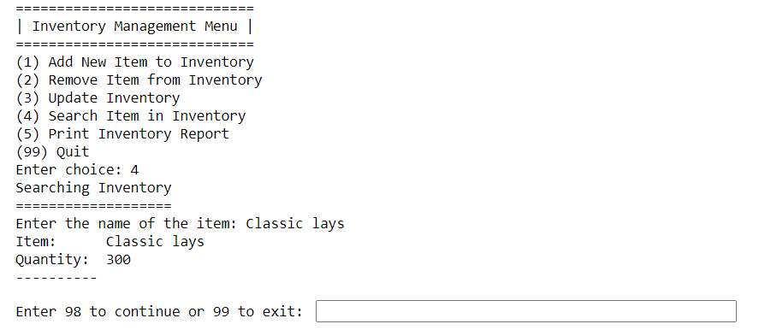
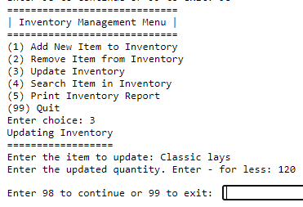
Features of designed system
For adding a new item and Searching for an item
For updating and deleting an item
A complete report of the inventory

Slide 6
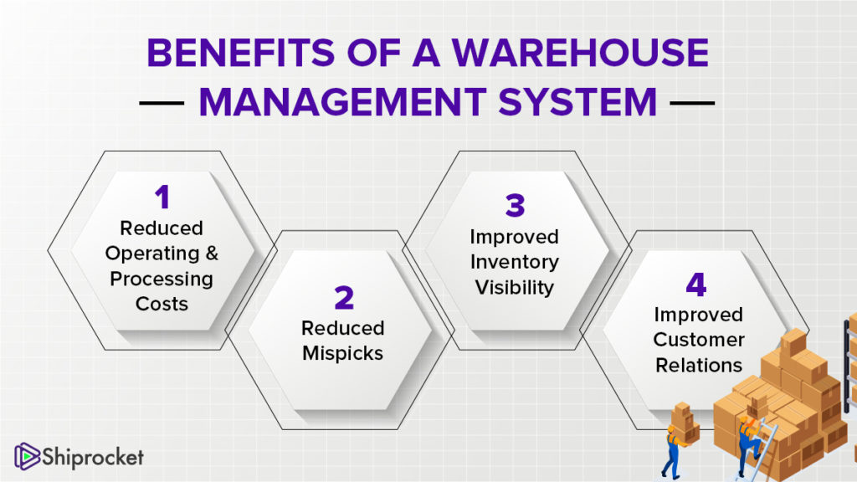
Result
Without an inventory management system, the goods and products that flow through an organization will inevitably be in disarray. An inventory management system enables a company to maintain a centralized record of every asset and item in the control of the organization, providing a single source of truth for the location of every item, vendor and supplier information, specifications, and the total number of a particular item currently in stock.
Because inventory often consists of movable assets, inventory management systems are critical for keeping tabs on current stock levels and understanding what items move quickly and which items are more slow-moving, which in turn enables organizations to determine when it’s time to reorder with greater accuracy. Overall, a comprehensive inventory management system offers countless benefits to companies including:

Slide 7
Improved cash flow
Better reporting and forecasting capabilities
Reduction in storage costs (overhead)
Reduced labor costs
Reduction in dead stock
Better organization
Enhanced transparency
Improved supplier, vendor, and partner relationships
CONCLUSION
If we had run the whole code at once without defining the function the processing time of the program would have increased using different function for different types of role to be played by the user makes the program efficient as it allows only that part of the code to be run which the user want to use hence increasing the efficiency. We have also used loops to iterate through the data and selectively identify the data which is of interest to the user.

Slide 8
REFERENCES
https://www.youtube.com/watch?v=W4qU4YeC-cs
https://www.pythontutorial.net/python-basics/python-read-text-file/
https://www.pythonforbeginners.com/basics/python-list-manipulationhttps:
//www.pythonforbeginners.com/basics/python-list-manipulation
https://www.youtube.com/watch?v=LUoKlnK5wcc

